Slide 1
JSPM’s BHIVARABAI SAWANT INSTITUTE OF TECHNOLOGY AND RESEARCH, WAGHOLI
Unit 1:Software Testing Introduction
Prof. Adsure Sharad S.

Slide 2
Vision Mission
Institute Vision
"Satisfy the aspirations of youth force, who want to lead nation towards prosperity through techno-economic development."
Institute Mission
To provide, nurture and maintain an environment of high academic excellence, research & entrepreneurship for all aspiring students, which will prepare them to face global challenges maintaining high ethical and moral standards."
Department Vision
Empowering the students to be professionally competent & socially responsible for techno-economic development of society.
Department Mission
To provide quality education enabling students for higher studies, research & entrepreneurship
To inculcate professionalism and ethical values through day to day practices.

Slide 3
Objectives
To understand testing techniques that are geared to discover program faults
To introduce guidelines for interface testing
To understand specific approaches to object-oriented testing
To understand the principles of CASE tool support for testing

Slide 4
TOPICS COVERED
Introduction
Historical perspective
Definition, Core Components
Quality View
Customers suppliers and process
Total Quality Management(TQM)
Quality practices of TQM
Quality Management through- Statistical process Control
Continual Improvement cycle
Quality in different areas
Benchmarking and metrics
Problem Solving Techniques
Problem Solving Software Tools.

Slide 5
(Conti..)
Software Quality.
Constraints of Software Product.
Customer is a King.
Quality and Productivity Relationship.
Requirements of Products.
Organization Culture.
Software Development Process.
Types of Product.
Problematic areas of SDLC.
Software Quality Management.
Why Software has a defects?
Processes related to Software Quality.
Pillars of Quality Management System.
Important aspects of quality Management.

Slide 6
Introduction
Software Quality
Quality: The degree to which a component, system or process meets specified requirements and/or user/customer needs and expectations.
Software Quality: The totality of functionality and features of a software product that bear on its ability to satisfy stated or implied needs.
Software Quality Is The Degree Of Conformance To Explicit Or Implicit Requirements And Expectations.
Explicit: clearly defined and documented
Implicit: not clearly defined and documented but indirectly suggested
Requirements: business/product/software requirements
Expectations: mainly end-user expectations
Software testing is a process of executing a program or application with the intent of finding the software bugs.
It can also be stated as the process of validating and verifying that a software program or application or product: Meets the business and technical requirements that guided it’s design and development
Works as expected

Slide 7
Conti..
The software system needs to be checked for its intended behavior and direction of progress at each development stage to avoid duplication of efforts, time and cost overruns, and to assure completion of the system within stipulated time. The software system needs to be checked for its intended behavior and direction of progress at each development stage to avoid duplication of efforts, time and cost overruns, and to assure completion of the system within stipulated time.
System testing and quality assurance come to aid for checking the system. It includes −
Product level quality (Testing)
Process level quality.

Slide 8
Introduction
A strategy for software testing integrates the design of software test cases into a well-planned series of steps that result in successful development of the software
It is the process used to identify the correctness, completeness and quality of developed computer software.
It is the process of executing a program/application under positive and negative conditions by manual or automated means. It checks for the :-
Specification ,Functionality, Performance
The strategy provides a road map that describes the steps to be taken, when, and how much effort, time, and resources will be required
The strategy incorporates test planning, test case design, test execution, and test result collection and evaluation
The strategy provides guidance for the practitioner and a set of milestones for the manager
Because of time pressures, progress must be measurable and problems must surface as early as possible

Slide 9
Why Is Software Testing Important?
SOFTWARE TESTING is defined as an activity to check whether the actual results match the expected results and to ensure that the software system is Defect free. It involves execution of a software component or system component to evaluate one or more properties of interest.Software testing also helps to identify errors, gaps or missing requirements in contrary to the actual requirements.
Testing is important because software bugs could be expensive or even dangerous. Software bugs can potentially cause monetary and human loss, and history is full of such examples.
In April 2015, Bloomberg terminal in London crashed due to software glitch affected more than 300,000 traders on financial markets. It forced the government to postpone a 3bn pound debt sale.
Nissan cars have to recall over 1 million cars from the market due to software failure in the airbag sensory detectors.
In 2015 fighter plane F-35 fell victim to a software bug, making it unable to detect targets correctly.
Programmers may make a mistake during the implementation of the software.

Slide 10
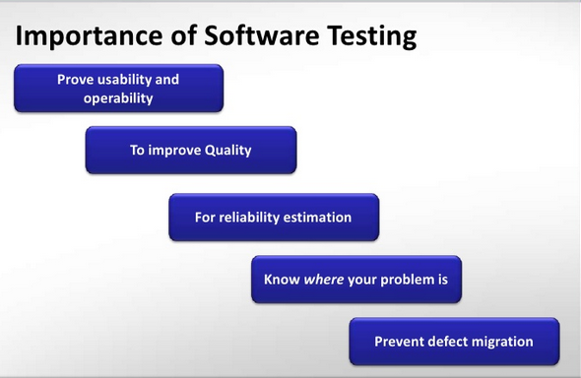

Slide 11
Definitions of Software Testing
Testing is the process of executing a program with the intent of finding errors
The process or method of finding error/s in a software application or program so that the application functions according to the end user's requirement is called software testing.
SOFTWARE TESTING is defined as an activity to check whether the actual results match the expected results and to ensure that the software system is Defect free.
It is a process, to evaluate the functionality of a software application with an intent to find whether the developed software met the specified requirements or not and to identify the defects to ensure that the product is defect-free in order to produce the quality product.
According to ANSI/IEEE 1059 standard – A process of analyzing a software item to detect the differences between existing and required conditions (i.e., defects) and to evaluate the features of the software item.
Testing is a destructive, even sadistic, process, which explains why most people find it difficult

Slide 12
What Are Software Testing Objectives & Purpose?
Software Testing has different goals and objectives. The major objectives of Software testing are as follows:
Finding defects which may get created by the programmer while developing the software.
Gaining confidence in and providing information about the level of quality.
To prevent defects.
To make sure that the end result meets the business and user requirements.
To ensure that it satisfies the BRS that is Business Requirement Specification and SRS that is System Requirement Specifications.
To gain the confidence of the customers by providing them a quality product.

Slide 13
Stages Of System Testing
Test Strategy
It is a statement that provides information about the various levels, methods, tools, and techniques used for testing the system.
It should satisfy all the needs of an organization.

Slide 14
Test Plan
It provides a plan for testing the system and verifies that the system under testing fulfils all the design and functional specifications. The test plan provides the following information −
Objectives of each test phase
Approaches and tools used for testing
Responsibilities and time required for each testing activity
Availability of tools, facilities, and test libraries
Procedures and standards required for planning and conducting the tests
Factors responsible for successful completion of testing process

Slide 15
Test Case Design
Test cases are used to uncover as many errors as possible in the system.
A number of test cases are identified for each module of the system to be tested.
Each test case will specify how the implementation of a particular requirement or design decision is to be tested and the criteria for the success of the test.
The test cases along with the test plan are documented as a part of a system specification document or in a separate document called test specification or test description.

Slide 16
Test Procedures
It consists of the steps that should be followed to execute each of the test cases. These procedures are specified in a separate document called test procedure specification. This document also specifies any special requirements and formats for reporting the result of testing.
Test Result Documentation
Test result file contains brief information about the total number of test cases executed, the number of errors, and nature of errors. These results are then assessed against criteria in the test specification to determine the overall outcome of the test.

Slide 17
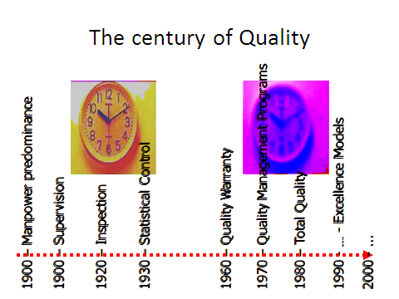
Historical Perspective
Glenford J. Myers initially introduced the separation of debugging from testing in 1979. Although his attention was on breakage testing ("A successful test case is one that detects an as-yet undiscovered error.") it illustrated the desire of the software engineering community to separate fundamental development activities, such as debugging, from that of verification.

Slide 18
Definitions Of Quality
Customer-Based Definition of Quality:-Quality must have fitness foe use and meet customer needs ,requirements and help in achieving customer satisfaction and customer delight.
Manufacturing-Based Definition of Quality:-This approach gives conformance to requirements.
Product-Based Definition of Quality:-Product must have something that other similar products do not have which help customer satisfy their needs in better way.
Value-Based Definition of Quality:-Customer must get value for his investment by buying product.
Transcendent Quality:- A product must have zero defects so that it does not prohibit normal usage by the users.

Slide 19
Core Components Of Quality
Quality is based on Customer satisfaction by acquiring a product.
The organization must define quality parameters before it can be achieved. The cycle of measurement include, Define , Measure, Monitor, Control, Measure.
Management Must Lead Organisation through improvement efforts.
Continuous Process improvement is necessary.

Slide 20
Quality Definition
Different way to explain Quality.
Transcendental view
User view
Manufacturing view
Product view
Value-based view
User view
Quality concerns the extent to which a product meets user needs and expectations.
Is a product fit for use?
This view is highly personalized.
A product is of good quality if it satisfies a large number of users.
It is useful to identify the product attributes which the users consider to be important.
This view may encompass many subject elements, such as usability, reliability, and efficiency

Slide 21
(cont.…)
Transcendental view
Quality is something that can be recognized through experience, but not defined in some tractable form.
A good quality object stands out, and it is easily recognized.
Manufacturing view
This view has its genesis in the manufacturing industry – auto and electronics.
Key idea: Does a product satisfy the requirements?
Any deviation from the requirements is seen as reducing the quality of the product.
The concept of process plays a key role.
Products are manufactured “right the first time” so that the cost is reduced
Development cost
Maintenance cost
Conformance to requirements leads to uniformity in products.
Some argue that such uniformity does not guarantee quality.
Product quality can be incrementally improved by improving the process.

Slide 22
(cont.…)
Product view
Hypothesis: If a product is manufactured with good internal properties, then it will have good external properties.
One can explore the causal relationship between internal properties and external qualities.
Example: Modularity enables testability.
Value-based view
This represents the merger of two concepts: excellence and worth.
Quality is a measure of excellence, and value is a measure of worth.
Central idea
How much a customer is willing to pay for a certain level of quality.
Quality is meaningless if a product does not make economic sense.
The value-based view makes a trade-off between cost and quality.

Slide 23
Total Quality Management(TQM)
Quality Principles of TQM
Develop Consistency of purpose of definition, Development of initiatives
Adapting New Philosophy of making people / Stockholders
Declare freedom from mass inspection of incoming / produced output
Stop awarding of lowest price tag contract to suppliers.
Improve every process used for development and testing.
Institutionalize training across the organization for all.
Institutionalize leadership throughout the organization.
Drive out fear of failure from employee.
Breakdown barriers between Function / Departments.
Eliminate Exhortation by numbers, goals , targets.
Eliminates arbitrary numerical targets which not supported by process.
Encourage Education of new Skills.

Slide 24
Quality View by different Stakeholder
Stakeholders are the people or entities interested in success/ failure of project / product or organization. some quality models put all stockholders for project in 6 major categories
Customer:
Delivering right product
Satisfy Customers need
Meeting customers expectation
Treating every customer with integrity, respect.
Employee
Supplier
Management
Society
Government

Slide 25
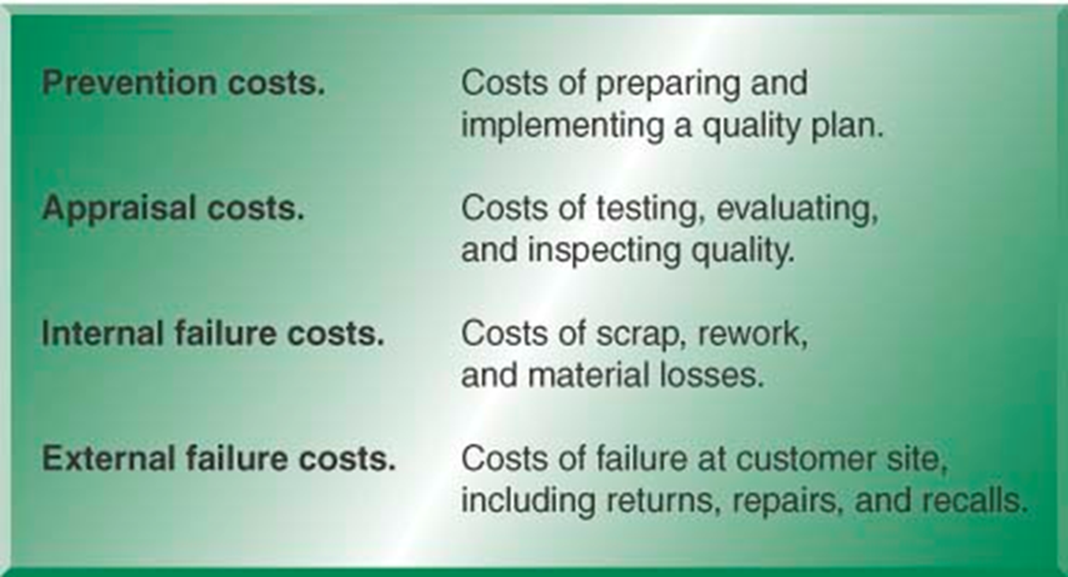
Financial Aspect Of Quality
-Quality affects all aspects of the organization
-Quality has dramatic cost implications of:
Quality control costs
Prevention costs
Appraisal costs
Quality failure costs
Internal failure costs
External failure costs
Sales Price is defined as,
Sales Price=Cost of Manufacturing+
Cost of Quality + Profit

Slide 26
Customer ,Suppliers And Processes
For any Organisation ,there are some suppliers supplying the inputs required and some customers who will be buying the output produced.
Supplier and customers may be internal or external to the organization.
External supplier provide input to the organization and external customers receive the output of the organization.
Suppliers may be customer for some organization and external customers receives the output of the organization.
Internal Customer:
Internal customer are the functions and projects serviced and supported by some other functions / projects. System administration may have projects as their customer while purchasing may have system administration as their customer.
External Customer:
External customer are the external people to the organization who will be paying for the services offered by the organization.

Slide 27
Total Quality Management(TQM)
Total Quality Management (TQM) efforts to position a company for greater customer satisfaction, profitability and competitiveness.
TQM principle intends to view internal and external customers as well as internal and external suppliers for each process and project and entire organization as whole
Meeting Our Customer’s Requirements
Doing Things Right the First Time; Freedom from Failure (Defects)
Consistency (Reduction in Variation)
Continuous Improvement
Quality in Everything We Do

Slide 28
TQM (Conti..)
Focus on Customer
Identify and meet customer needs
Stay tuned to changing needs, e.g. fashion styles
Continuous Improvement
Continuous learning and problem solving, e.g. Kaizen, 6 sigma
Plan-D-Study-Act (PDSA)
Benchmarking
Employee Empowerment
Empower all employees; external and internal customers
Team Approach
Teams formed around processes – 8 to 10 people
Meet weekly to analyze and solve problems
Use of Quality Tools
Ongoing training on analysis, assessment, and correction, & implementation tools
Studying practices at “best in class” companies

Slide 29
Categories of requirement
Stated / Implied
General / Specific
Must be / Must not be
Should be / Should not be
Could be / Could not be
Current / Future

Slide 30

Organization culture
Quality culture in Q | Quality culture in q
They believes in listening to customer and det. Their requirement | They think they know the customers requirement.
These org. concentrated on identifying cost of quality | These org. overlook cost of poor quality and hidden effect.
Doing things right for the first time and every time | Doing the things again and again to make things right.

Slide 31
Quality Management Through Statically Process Control
Statistical process control is a collection of tools that when used together can result in process stability and variance reduction
Statistical Process Control (SPC) is an industry-standard methodology for measuring and controlling quality during the manufacturing process.
Quality data in the form of Product or Process measurements are obtained in real-time during manufacturing. This data is then plotted on a graph with pre-determined control limits. Control limits are determined by the capability of the process, whereas specification limits are determined by the client's needs.
Quality Planning at all level
Quality Planning at Organization level.
Quality Planning at Unit level.
Statistical Process Control
monitoring production process to detect and prevent poor quality
Sample
subset of items produced to use for inspection

Slide 32
Quality Management Through Cultural Changes
Quality Management through cultural change defines quality improvements as a cultural change driven by management. It involves
-Identifying areas in which quality can be improved depending upon process capability measurements and organizational priorities.
-Identifying teams representing different functions and areas for quality improvement can help in setting the change of culture.
-Setting measurable goals in each areas of an organization can help in improving processes at all levels.
-Giving recognition to achievers of quality goals will boost their morale and set positive competition among team leading to organizational improvements.
Creating a quality culture within an organization is increasingly recognized as one of the primary conditions for the successful implementation of Total Quality Management

Slide 33
Continual Improvement Cycle(conti)
Continuous improvement is an ongoing effort to improve products, services or processes. These efforts can seek “incremental” improvement over time or “breakthrough” improvement all at once.
Among the most widely used tools for continuous improvement is a four-step quality model—the plan-do-check-act (PDCA) cycle, also known as Deming Cycle or Shewhart Cycle:
Plan: Identify an opportunity and plan for change.
Do: Implement the change on a small scale.
Check: Use data to analyze the results of the change and determine whether it made a difference.
Act: If the change was successful, implement it on a wider scale and continuously assess your results. If the change did not work, begin the cycle again.

Slide 34
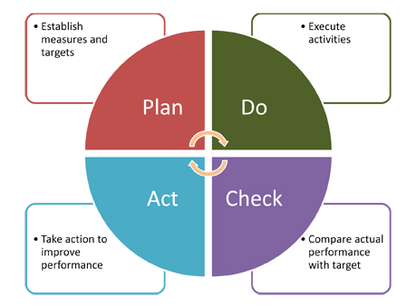
Continual Improvement Cycle
Fig.PDCA Cycle

Slide 35
Quality In Different Areas
Quality attributes of various products in different areas..
Different domains need different quality factors. They may be derived from customers/users of the domains. Some examples of some domains showing customer expectations in terms of quality of various products.
Products and expected attributes
Products/Service Category | Expected Attributes
Airline Industry | On time arrival/departure, low cost service, comfortable journey etc.
Healthcare Industry | Correct treatment, minimum wait time ,safety and security .
Food Service Industry | Good Product, good taste, fast delivery, clean environment.
Military Services | Rapid deployment, Security
Automotive Industry | Clear communication, faster acess, cheaper service

Slide 36
SOFTWARE DEVELPOMENT PRCOESS
Following Software Development Process Models are used:
Waterfall Development Approach/Model.
Iterative Development Approach/Model
Incremental Development Approach/Model
Spiral Development Approach/Model
Prototyping Development Approach/Model
Rapid Development Approach/Model
Agile Development Approach/Model

Slide 37
Benchmarking And Metrics
Benchmarking:-It is important concept in Quality Function Deployment
It’s concept of qualitative /quantitative metrics or measurable variables which can used to access product quality on several scales against benchmarks.
Benchmarking include price of product paid by customer, time required to acquired to acquire it, customer satisfaction, defects, attributes and features of products.
Benchmarking means to measure the best practices of leading businesses, and learn and adapt them for use in your business.
Metrics:- They are defined for collecting information about the products capabilities, process variability and outcome of the process in terms of attributes of the product.
It is relative measurement of some parameters of a product which are related to the product and processes used to make it.

Slide 38
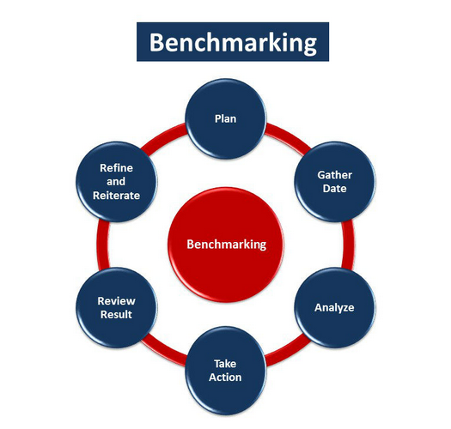
Conti…

Slide 39
Problem Solving Techniques
Techniques indicate more about a process used in measurement , analysis and decision making during problem solving.
Improving quality of products and services offered to customers requires methods and techniques of solving problems associated with development and processes used during their lifecycle.
An organization must use metrics approach of process improvement because it needs to make quantitative measurements.
These measurements can be accomplished by both qualitative and quantitative methods but problem definition becomes easier when we put some measures.
Qualitative problem solving refers to understanding a problem solution using only qualitative indexes such as high , medium ,low etc. depending on the something is improving from present status and so forth.
Quantitative problem solving requires specification of exact measures of exact measures in numerical terms such as the cost of the 32.5% during last quarter or time required to one product is reduced by 32 minutes.
It must follow define, measure,monitor,control and improve cycle.

Slide 40
Problem Solving Software Tools
Tools are an organizations analytical asset that assist in understanding a problem through data and try to indicate possible solutions.
Quality tools applied for solving problems face by projects and functional terms while improving quality in organization.
Tools may be hardware/software and physical/logical tools.
Advantages of Using Software Tools for analysis and decision making
-Accuracy and speed of the tools is much higher compared to performing all transactions and calculations manually.
-Decision support offered of the tool is independent of personal skills and there is least variation from instance to instance.
-Tools can be integrated with other systems to provide a systematic and highly integrated means of solving problems.
Disadvantages of Using Computer Tools for Analysis and Decision Making
-Tools may mean more cost and time to learn and implement.

Slide 41
Software Quality
Software Quality Views: The degree to which a system, component, or process meets specified requirements.
Quality is fitness for use.
Conformance to specification.
Transparency of service delivery
Achieving desired results
Continuous Improvement
Competitive advantage
Added value for society Best value for price
Cost effectiveness
Performance measurement
Satisfaction of stakeholders
Doing the right things
Doing things right
Doing the right things right

Slide 42
Constraints of Software Product Quality Assessment
Requirement specification are made by business analyst and system analyst. Tester may or may not have direct access to the customer and may get information though requirement statements, queries answered etc. either from customer or business analyst. There are few limitation of product quality assessment in this.
Software is virtual in nature. Software products can not be touched or heard.
There is huge communication gap between users of software and developers/testers of the product.
Software product is unique in nature. Similarities between any two products are superficial ones.
All aspects of software cannot be tested fully as member of permutations and combinations for testing all possibilities tend to infinity.
A software program in the same way every time when it is executing some instruction.

Slide 43
QUALITY TOOLS
Quality function deployment (QFD)
Taguchi techniques
Pareto charts
Process charts
Cause & effect diagrams
Statistical process control (SPC)

Slide 44
Customer is A king
External Customer - outside the organization (people who pay the bills.)
End-user customers
Manufacturer (OEM) for suppliers.
Internal Customer - people within your organization who receive your work
In many situations, producers have multiple customers and therefore find it useful to identify “core customers”
A customer’s perception is their reality.
It’s easier to keep your customers happy than attract new ones.
Complaints spread like wildfire on the internet.
Without customers we don’t have a business.
Brands win or lose by how well they wow customer.
TQM’s Customer Approach
“the customer defines quality.” “the customer is always right.”
“the customer always comes first.” “quality begins & ends with the customer.”

Slide 45
Quality And Productivity Relationship
Productivity is the relationship between a given amount of output and the amount of input needed to produce it. Quality affects productivity.
Productivity is tool of measurement that determines the efficiency of the organization in terms of the ratio of output produced with respect to inputs used.
Quality must improve productivity by reducing wastage.
Improvement in quality directly leads to improved productivity.
Cost reduction is possible by improved quality.
Proper communication between management and employee is essential.
Quality improvement lead to cost reduction.
Employee involvement in quality improvement.

Slide 46
Requirements Of Product
Stated/Implied Requirements: Functional and non functional requirements stated by customer.
General/Specific Requirement: Requirements are generic in nature.
Present/Future Requirements: Present when application is used and future for required after some time span.
Primary Requirements: Must /must not be requirements. Customer pay for this
Secondary Requirements: Should/Should not be requirements.
Tertiary Requirements: Could/could not be requirements.

Slide 47
ORGANIZATION CULTURE
Quality culture is set of group values that guide how improvements are made to everyday working practices and consequent outputs.
An organization’s values can help individuals at all levels make better and more responsible decisions relating issues of quality.
Following Features emerged as indicative of a quality culture
-Academic Ownership of quality.
-Quality culture is primarily about the behavior of stakeholders rather than the operation of a quality.
-A quality culture places students as center.
QUALITY
CONTROL
QUALITY
ASSURANCE
QUALITY
MANAGEMENT
Fig .Shift focus from quality control to quality management

Slide 48
TYPES OF PRODUCT
Life Affecting Products.
Product Affecting Huge Some of Money.
Products Which can be Tested only by Simulators :Example Space Research
Other Products.

Slide 49
CRITICALITY DEFINATIONS
From User’s Perspective:
-Failure of product disrupts entire business.
-Products failure affects business.
From Developer's Perspective
-This classification defines the complexity of the system on the basis of development capabilities required.

Slide 50
PROBLEMSTIC AREAS OF SDLC
Problems with requirement phase.
Requirements change very frequently.
Unique product is built in any time.
Product nature is intangible.
Inspection can be exhaustive.
Requirements are not easily communicated.
-Technical Requirements.
-Economical Requirements.
-Operational Requirements.
-System Requirements.

Slide 51
SOFTWARE QUALLITY MANAGEMNT
Quality management involves management of all inputs and processing defined so that the output from the process as per defined criteria.
It handles three levels of problems:
-Correction.
-Corrective Actions.
-Preventive Actions.

Slide 52
Quality Management System Structure
1st Tier-Quality policy
2nd Tier-Quality objectives
3rd Tier-Quality Manual

Slide 53
Pillars Of Quality Management System
Quality processes/Quality Procedures/work instructions
Guidelines and standards
Formats and Templates

Slide 54
Important Aspects Of Quality Management
Quality planning at organisation level
Quality planning at project level
Resource management
Work Environment
Customer Related Processes
Quality management system document and data control
Verification and validation
Software project management
Software configuration management
Software metrics and measurement
Software Quality Audits

Slide 55
The testing process
Component testing
Testing of individual program components
Usually the responsibility of the component developer (except sometimes for critical systems)
Tests are derived from the developer’s experience
Integration testing
Testing of groups of components integrated to create a system or sub-system
The responsibility of an independent testing team
Tests are based on a system specification

Slide 56
The defect testing process

Slide 57
Black-box testing
An approach to testing where the program is considered as a ‘black-box’
The program test cases are based on the system specification
Test planning can begin early in the software process

Slide 58
Black-box testing

